Slide 1


Sample Sales Data
https://drive.google.com/file/d/1rTBZ3Faaqmhj8Dzfx2Bqn8EVxvnWslrU/view?usp=sharing
https://www.kaggle.com/kyanyoga/sample-sales-data
Submitted By:
Komal More

Slide 2
Problem Statements :
Customer details, Top customer In different measures.
Number of count of each product.
Weekly Sales Information.
Country wise Information.
Year wise information of different product types in different measures.
Deal & Status wise product Information Of Different Measures

Slide 3
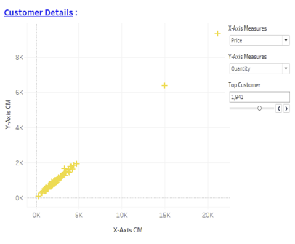
Customer Details :
From this Scatter Plot, it is easy to find customer information based on sales , price & quantity.
There is huge difference between top 2 & remaining customers in all measures.

Slide 4
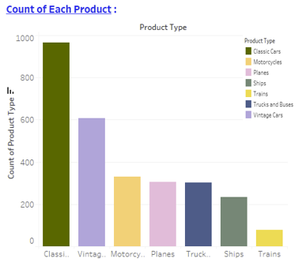
Count of Each Product :
In this Bar graph, Classic cars has more number of count and Trains has less number of count.
There are 3 products namely motorcycle, plans, trucks & buses have almost same number of counts.

Slide 5
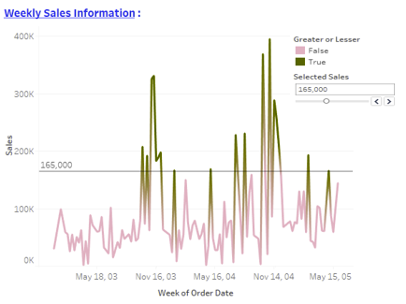
Weekly Sales Information :
From this Line chart we get weekly Information of sales.
There are high sales in the week of November 2003 & 2004 respectively.

Slide 6
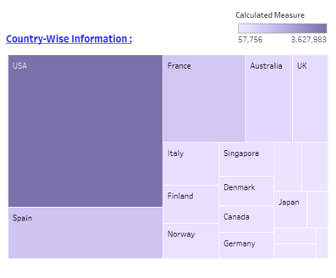
Country wise Information :
This Treemap chart shows different information of different countries like sales , total quantity in each country.
USA, Spain & France are Top 3 countries in different measures respectively.

Slide 7
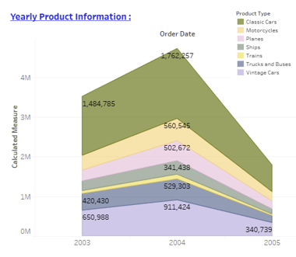
Yearly Product Information :
This Area chart gives us year-wise product information on the basis of different measures.
It shows there is huge increase in sales in 2004 of classic cars.

Slide 8
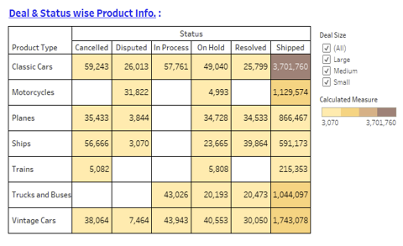
Deal & Status wise Product Information :
This Heat map table is helpful for getting status-wise product information of different measures.
There is high number of shipped products of classic cars.

Slide 9
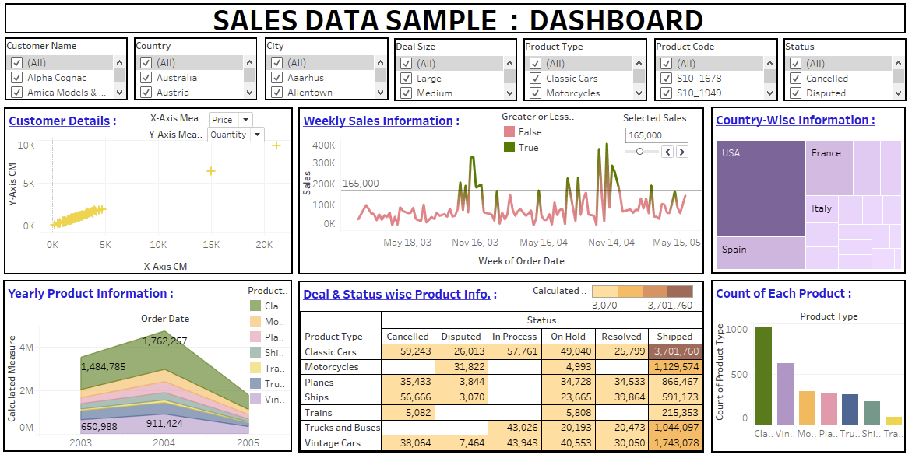

Slide 10
Conclusion :
There is huge difference between top 2 & remaining customers in all measures in Customer Details.
High sales in November 2003 & 2004 .
USA, Spain & France are Top 3 countries in different measures respectively.
Classic Cars has shipped the most products out of all the Products & has Maximum number of count.
Classic cars, vintage cars, motorcycle , Trucks & buses are the top 4 categories in sales.
Train category has lowest number of count & sales thus need improvement .

Slide 11
THANK YOU !!!

